Slide 1

St. Joseph's University, Bengaluru
Department of Advanced Computing | Academic Year 2026–2027
CUSTOMER CHURN PREDICTION USING MACHINE LEARNING AND POWER BI
Machine Learning Lab – Final Examination
Team Members
Sam Joshuva
241BCADA19
Muhammed Sinan
241BCADA70
Jonathan Jijoy
241BCADA26
Muhammed Adir
241BCADA13
Siddharth S
241BCADA44
Notes:
Introduce the project title, team and institution.

Slide 2
2. Problem Statement & Objective
Problem Statement
Input → Output
Customer churn occurs when customers discontinue a service.
The project predicts whether a telecom customer is likely to churn, using customer, service, contract, satisfaction and financial information.
Output: a binary churn prediction along with a churn probability / risk level.
Input: customer, service, contract, satisfaction and financial attributes
Output: churn prediction + probability / risk level
Objectives
Target: Churn Value
Integrate multiple telecom customer datasets; clean, preprocess and analyse the data.
Develop and compare Logistic Regression and XGBoost models.
Identify important factors associated with churn prediction.
Build a Power BI dashboard for churn and customer-risk analysis.
0
No Churn
1
Churn
Machine Learning Lab – Final Exam Project
Notes:
Binary classification: predict whether a telecom customer will churn.

Slide 3
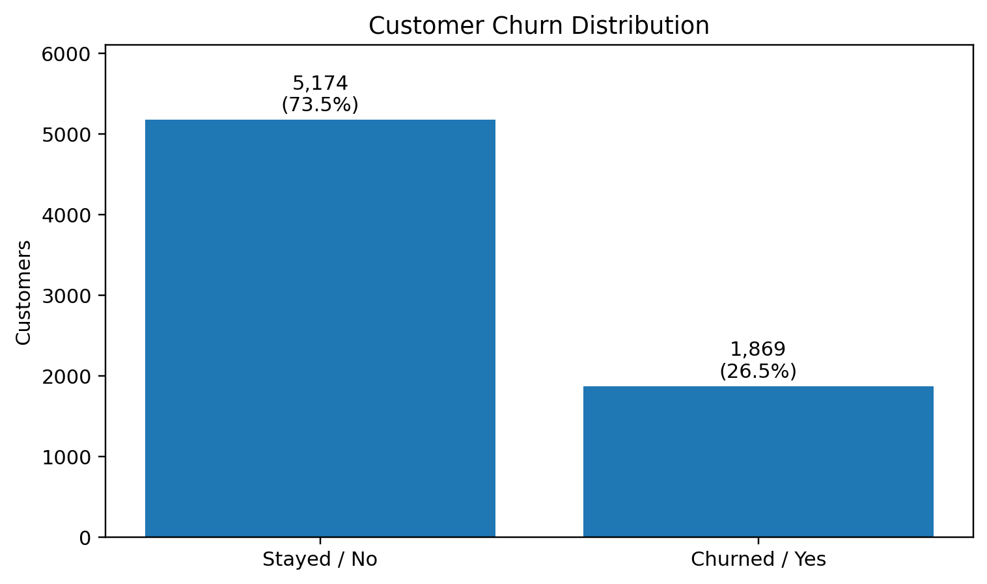
3. Dataset & Data Understanding
Combined Telecom Customer Churn Dataset • Sources: Demographics, Services, Status, Location, Population
7,043
61
5
Customers
Features / Columns
Source Tables
Important Features
Age
Tenure
Contract
Internet Service / Type
Satisfaction Score
Monthly Charge
Total Charges
CLTV
Payment Method
Dataset limitation: the dataset is static and contains some missing categorical values. Its size suits a lab-scale project but may not represent a complete production telecom population.
73.5%
26.5%
Non-Churn: 5,174
Churn: 1,869
Machine Learning Lab – Final Exam Project
Notes:
Target: Churn Value. The classes are imbalanced (73.5% vs 26.5%).

Slide 4
4. Data Preparation & EDA
Data Preparation
Five source tables integrated using Customer ID and Zip Code.
Duplicate Customer IDs / Zip Codes checked; no complete-row duplicates found.
Identifier and target-derived fields removed before modelling.
Categorical variables encoded with One-Hot Encoding.
Missing values handled during preprocessing.
Outliers inspected with boxplots and IQR (676 observations outside IQR bounds for Number of Referrals).
26.5%
Overall churn rate
Satisfaction Score
most important XGBoost feature
Machine Learning Lab – Final Exam Project
Notes:
Month-to-month customers churn far more than one- or two-year contract customers.

Slide 5
5. Machine Learning Approach
Problem type: Binary Classification
1. Logistic Regression
2. XGBoost
Baseline model
Final tree-based boosting model
Simple, interpretable classification benchmark.
Captures nonlinear relationships and interactions between customer attributes.
Train-Test Split
XGBoost Configuration
80%
20%
Stratified sampling • random_state = 42
300
5
0.05
0.8
0.8
Train: 5,634
Test: 1,409
estimators
max depth
learning rate
subsample
col. sample
Parameters were manually configured; no GridSearchCV / RandomizedSearchCV was performed.
Machine Learning Lab – Final Exam Project
Notes:
Final model: XGBoost Classifier.

Slide 6
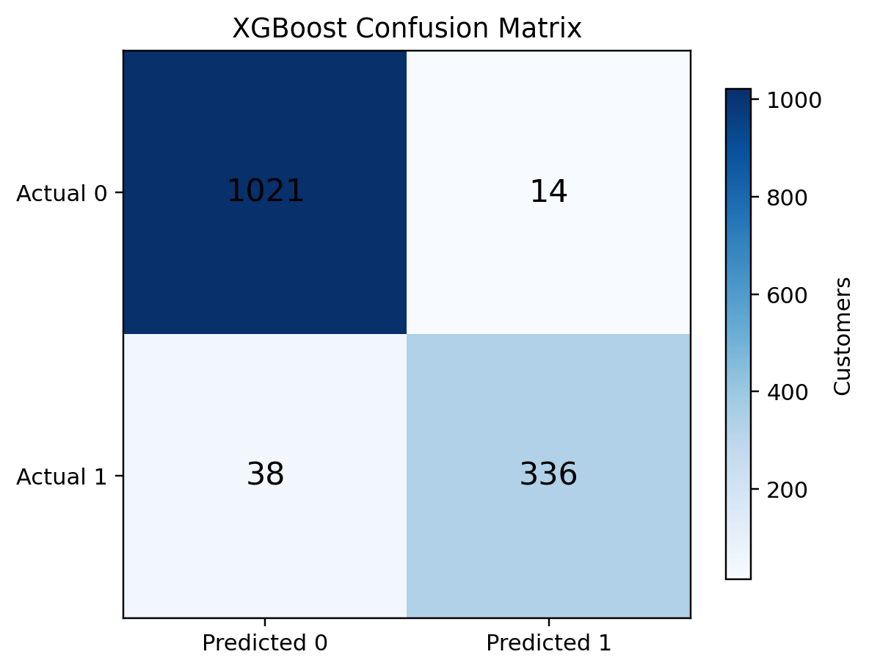
6. Model Evaluation
Model | Accuracy | Precision | Recall | F1 | ROC-AUC
Logistic Regression | 91.2% | 0.85 | 0.82 | 0.83 | Not recorded
XGBoost (final) | 96.0% | 0.96 | 0.90 | 0.93 | 0.9924
XGBoost reached 96.0% accuracy with 0.90 recall, 0.93 F1-score and 0.9924 ROC-AUC on the recorded test set.
Why these metrics?
Churn is the minority class, so precision, recall, F1 and ROC-AUC are read alongside accuracy.
Only 38 of 374 churners were missed (false negatives); 14 false alarms among 1,035 non-churners.
True Neg 1,021 | False Pos 14 | False Neg 38 | True Pos 336
Machine Learning Lab – Final Exam Project
Notes:
Confusion matrix on the 1,409-record test set.

Slide 7
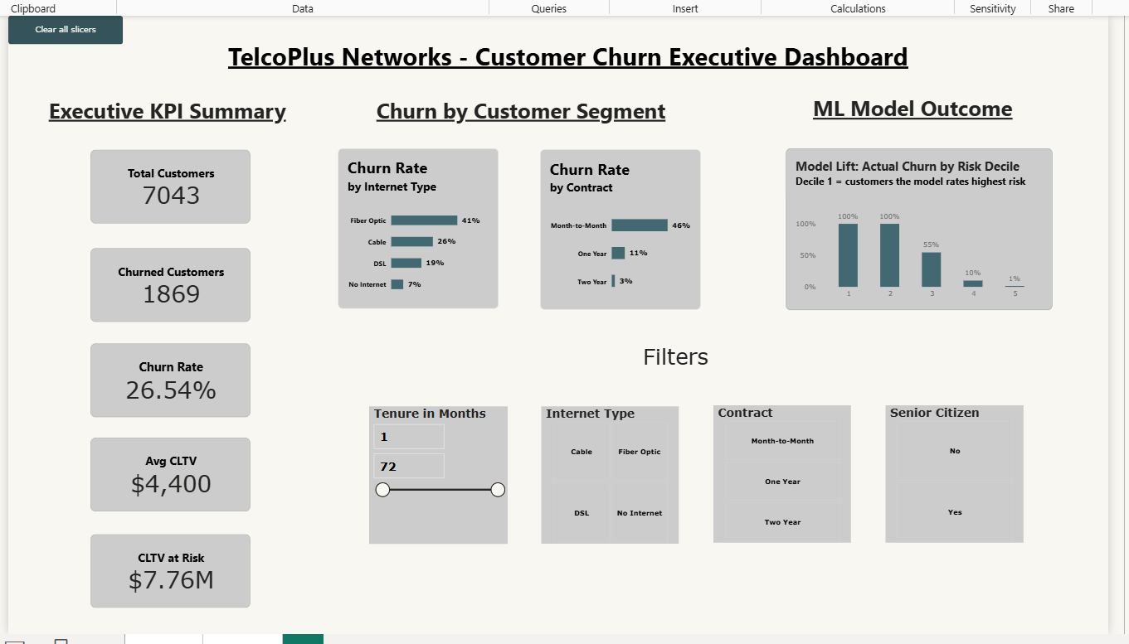
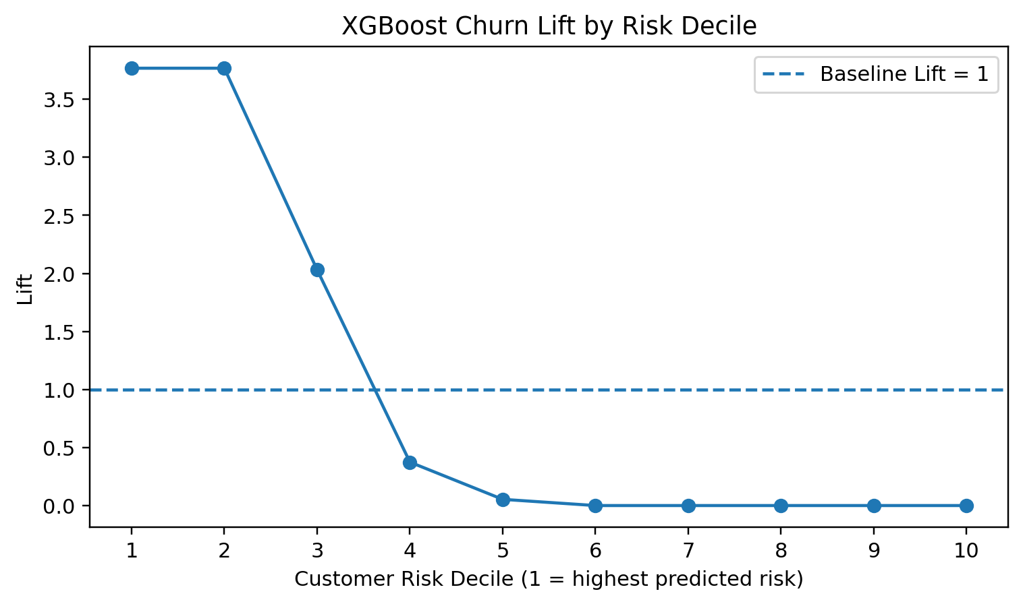
7. Results & Dashboard / Visualization
7,043
1,869
26.5%
$4,400
$7.76M
Customers
Churned
Churn Rate
Avg. CLTV
CLTV at Risk
Top-10% Lift: 3.77
350 predicted churners in the test analysis represent $1.46M CLTV. The $7.76M KPI is the dashboard’s portfolio-level figure – a different scope.
Power BI executive dashboard (page 1)
Machine Learning Lab – Final Exam Project
Notes:
Highest-risk deciles hold most actual churners, so retention effort can be prioritised.

Slide 8
8. Live Demo
CUSTOMER CHURN PREDICTION — END-TO-END DEMO
Data Integration
›
Data Cleaning
›
EDA
›
Preprocessing
›
ML Prediction
›
Risk Analysis
›
Power BI Dashboard
What the System Does
We will now open the actual project
Combines telecom customer data from multiple sources.
Preprocesses attributes for machine learning.
Uses the trained XGBoost model to predict churn.
Generates a churn probability and predicted outcome.
Analyses customer risk, lift and CLTV at risk.
Shows results in an interactive Power BI dashboard.
Dataset and preprocessing
Model prediction
Churn probability
Customer-risk output
Power BI dashboard and interactive filters
Machine Learning Lab – Final Exam Project
Notes:
Keep screenshots ready as backup while demonstrating the live project.

Slide 9
9. Challenges & Improvements
Challenges Faced
Current Limitations
Future Improvements
Integrating five datasets with different structures.
Handling missing categorical values.
Preventing target-derived fields from entering the model.
Managing class imbalance.
Converting model outputs into useful Power BI visuals.
Dataset is static, not live.
Single stratified 80:20 split for evaluation.
No systematic hyperparameter search.
Feature importance shows model behaviour, not causation.
Not deployed as a production service.
Use larger, more recent customer datasets.
Systematic hyperparameter tuning.
Time-based validation.
Production prediction service.
Automated retention workflows.
Machine Learning Lab – Final Exam Project

Slide 10
10. Team Contribution, Learning & Conclusion
Member | Role
Sam Joshuva | Data Engineer & Data Scientist
Muhammed Sinan | Data Analyst
Jonathan Jijoy | ML Engineer
Muhammed Adir | Analytical Engineer
Siddharth S | Power BI Developer
Conclusion
An end-to-end churn prediction system built on 7,043 telecom customer records. XGBoost achieved 96.0% accuracy and 0.9924 ROC-AUC, and the Power BI dashboard turns model outputs into customer-risk and business insights.
Learning
Data integration & cleaning
Exploratory Data Analysis
Future Scope: systematic tuning, larger datasets, time-based validation and production deployment.
Classification modelling
XGBoost & model evaluation
Feature importance & lift analysis
Power BI dashboard development
GitHub: github.com/broCode9686/ml_project
Machine Learning Lab – Final Exam Project

